Slide 1
Treating Tobacco Dependence in 2011
Richard D. Hurt, M.D.
Professor of Medicine
Director, Nicotine Dependence Center
Mayo Clinic
rhurt@mayo.edu
http://ndc.mayo.edu

Slide 2
Richard D Hurt MD
Financial Disclosure 1/10
Current consulting (Scientific Advisory Boards) : GSK
Current Industry Grants: Pfizer Medical Education Grant
Past Consulting: Glaxo Wellcome, Elan, Dynagen, Mcneil, Lederle, Bristol Myers Squibb, Pharmacia, Inhale, Novartis
Past Industry Grants: Glaxo Wellcome, Mcneil, Dupont Merck, Elan, Lederle, Lily, Pfizer, SANO, GlaxoSmithKline, Knoll, Sanofi- Synthelabo, Somaxon

Slide 3
52 Y/O Married Man With Back Pain
Smoker since age 14 smoked 40 cpd until a 2 months ago, now smoking 20-30 cpd.
Wife is an ex-smoker but very supportive.
Smokes first cigarette within 5 minutes of arising in the morning.
Longest period of smoking abstinence 1 month- nicotine patch but had w/d.
Nicotine gum and bupropion did not relieve cravings. Varenicline no help in stopping smoking.

Slide 4
52 Y/O Married Man With Back Pain
What phramcotherapy?
A. Bupropion + nicotine gum
B. 21 mg nicotine patch + nicotine inhaler
C. 2- 21 mg nicotine patches + nicotine inhaler.
D. Varenicline

Slide 5
Treating Tobacco Dependence in a Medical Setting
Best Practices
USPHS Guideline (www.ahrq.gov)
Behavioral, addictions, pharmacologic treatment, and relapse prevention
Neurobiology of tobacco dependence
“Teachable moment”
Telephone quitlines
Public policy-Taxes and smoke-free workplaces
Hurt RD, et al CA Cancer J Clin 59:314, 2009

Slide 6
Cigarettes and Tobacco Dependence
Cigarette smoke – complex mixture of 4,000 chemicals with over 60 known carcinogens
Most efficient delivery device for nicotine that exists- better than intravenous
Cigarette manufacturers have modified cigarettes over the past decades to maximize nicotine delivery to the brain
High doses of arterial nicotine cause upregulation of the nicotinic acetylcholine receptors
Genetic factors influence tobacco dependence
Left untreated 60% of smokers die from a tobacco-caused disease
Hurt RD, Robertson CR JAMA 280:1173, 1998

Slide 7
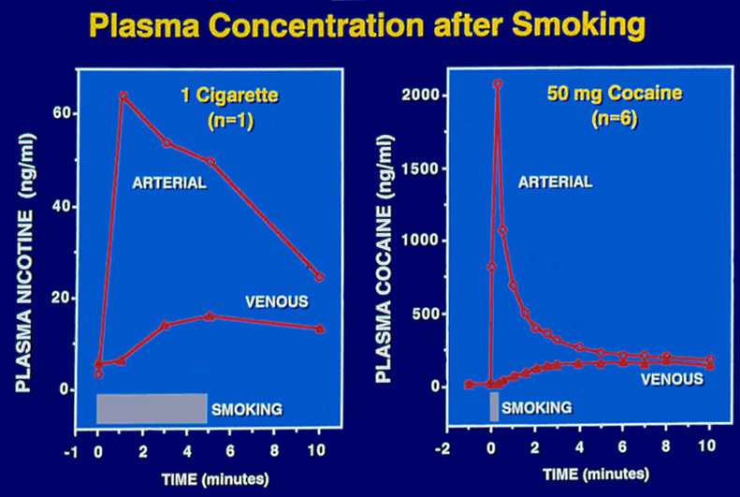

Slide 8
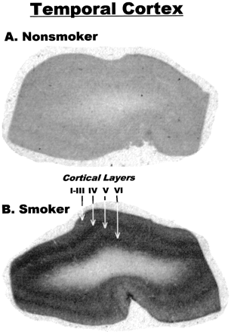
Perry, DC, et al. J Pharmacol Exp Ther, 289:1545, 1999

Slide 9
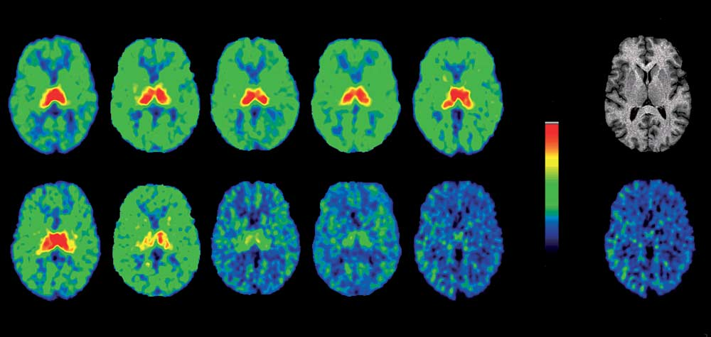
Smoking Saturates Nicotinic Receptors
MRI
kBq/mL
9
0
0.0 Cigarette
0.1 Cigarette
0.3 Cigarette
1.0 Cigarette
3.0 Cigarette
Nondisplaceable
Brody, A.L. Arch Gen Psychiatry. 63;907-915, 2006

Slide 10
2 A’s and an R
Ask about tobacco use
Advise to stop
Refer for counseling and pharmacotherapy
Internal resources- Counselors, group programs, TTS
External resources-Telephone quitlines, TTS Clinics, internet resources
Schroeder SA JAMA 294:482, 2005

Slide 11
USPHS Clinical Practice Guideline- 2008
Pharmacotherapy
First line
  nicotine gum
  nicotine patch
  nicotine lozenge
  nicotine nasal spray
  nicotine inhaler
  bupropion
  varenicline
  combinations
Second line
  clonidine
  nortriptyline

Slide 12
Cotinine
Major metabolite of nicotine
Pharmacologically inactive
Quantitative marker of nicotine intake
Pre-abstinence levels correlate with withdrawal and treatment outcome
Half-life 18-20 hours

Slide 13
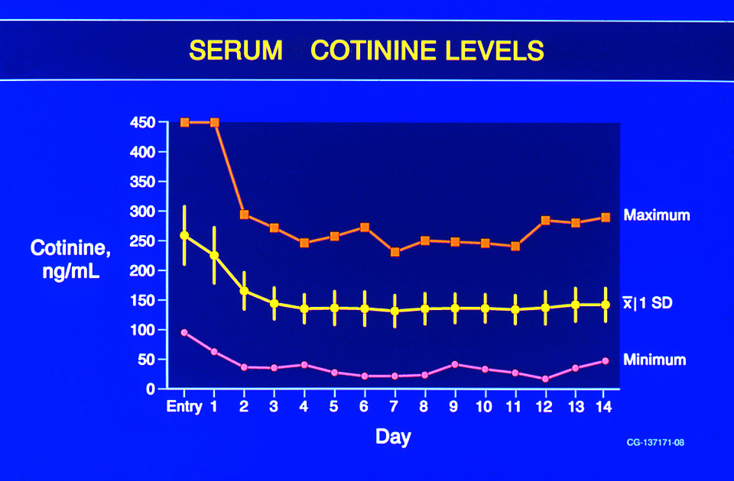
Hurt RD, et al. Clin Pharmacol Ther 54:98-106, 1993

Slide 14
Nicotine Patch Therapy
Background
Placebo-controlled trials show doubling of stop rates
Growing literature showing a dose response
~50% median replacement with standard dose
Reduced smoking while using nicotine patch

Slide 15
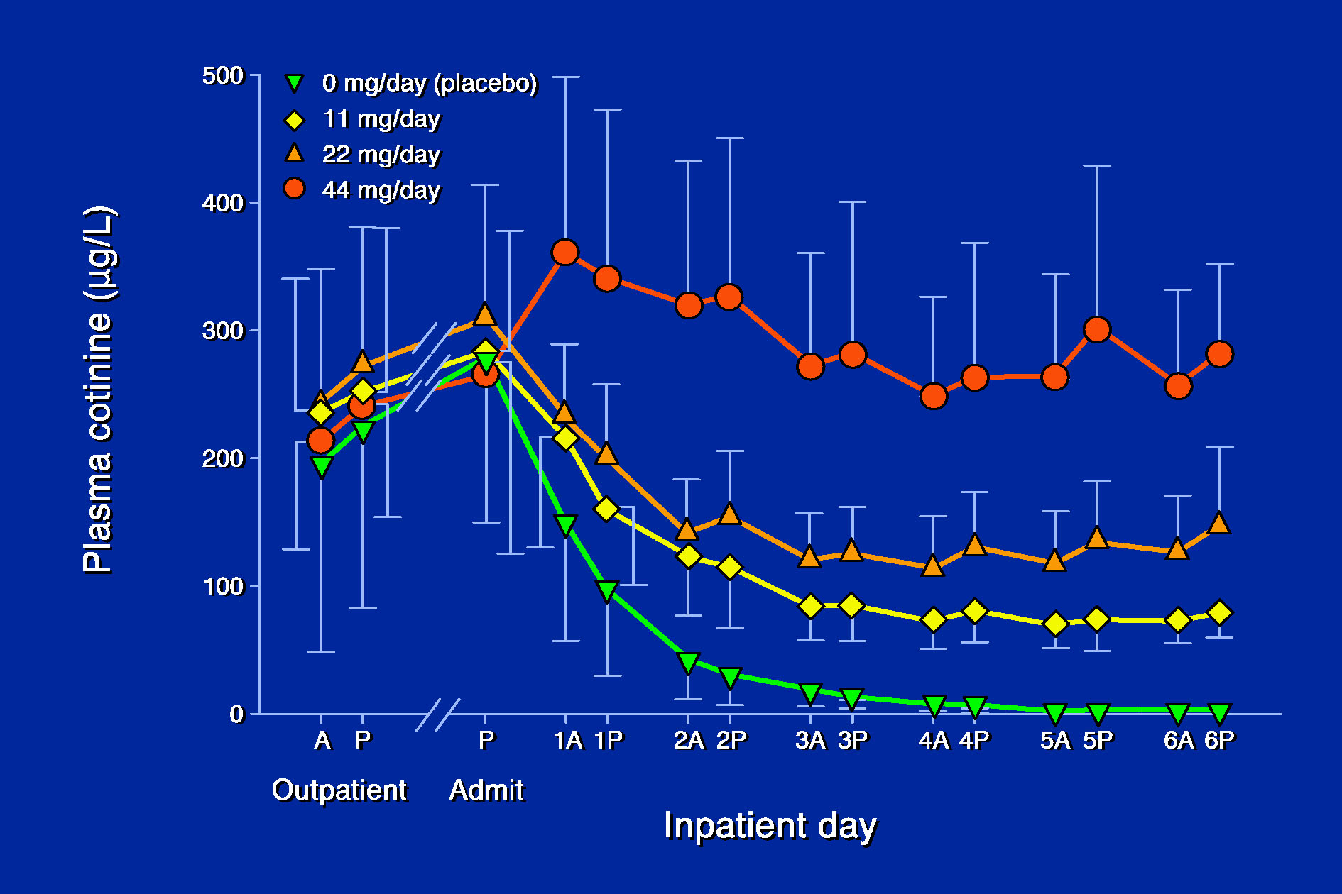
Lawson GM, et al. J Clin Pharmacol 38:502-509, 1998

Slide 16
High Dose Patch Therapy
Conclusions
High dose patch therapy safe for heavy smokers
Smoking rate or blood cotinine to estimate initial patch dose
Assess adequacy of nicotine replacement by patient response or percent replacement
More complete nicotine replacement improves withdrawal symptom relief
Higher percent replacement may increase efficacy of nicotine patch therapy
Dale LC, et al. JAMA 274:1353, 1995

Slide 17
High Dose Patch Therapy
Dosing Based on Smoking Rate
<10 cpd 7-14 mg/d
10-20 cpd 14-21 mg/d
21-40 cpd 21-42 mg/d
>40 cpd 42+ mg/d
Dale LC, et al. Mayo Clin Proc 75:1311, 1316, 2000

Slide 18
High Dose Patch Therapy
Dose Based on Plasma Cotinine
<200 ng/ml 14-21 mg/d
200-300 ng/ml 21-42 mg/d
>300 ng/ml 42+ mg/d
Dale LC, et al. JAMA 274:1353, 1995

Slide 19
Extended Nicotine Patch Therapy
24 weeks (n= 287) vs 8 weeks (288) 21 mg/d dose
Similar smoking abstinence at week 8
At week 24 point prevalence smoking abstinence 32% vs 20% (OR 1.81)
At week 52 prolonged smoking abstinence > with extended patch therapy (P=0.0270
Delayed relapse to smoking with extended patch therapy
Schnoll RA, et al Ann Int Med 152:144, 2010

Slide 20
Schnoll RA, et al. Annals of Intern Med 2010; (152)3:149

Slide 21
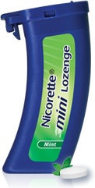
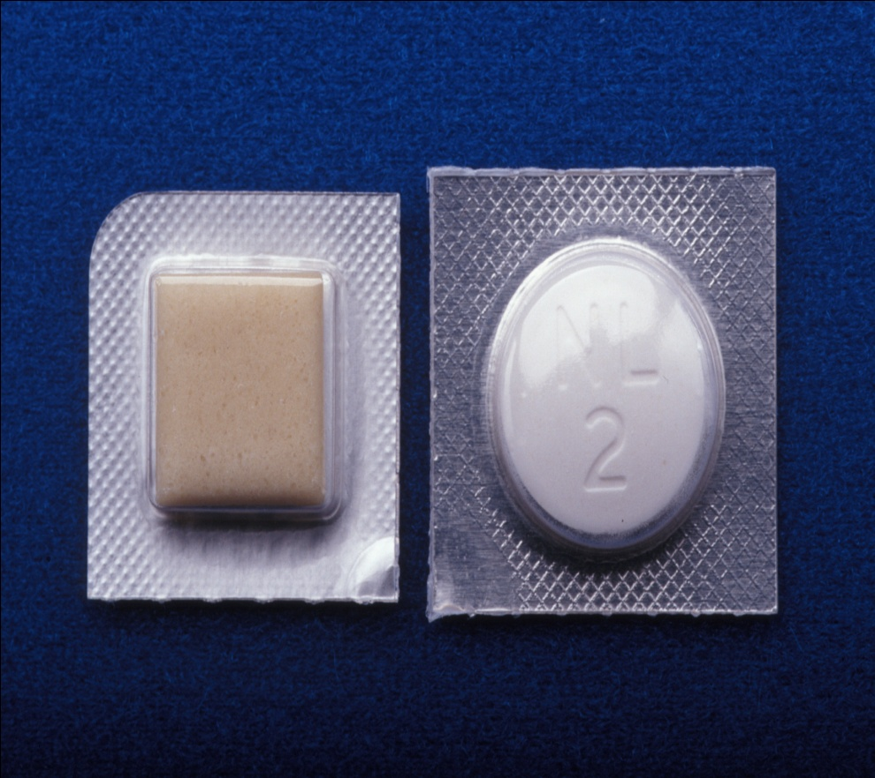
Nicotine Gum and Lozenges 2 & 4 mg Sizes

Slide 22
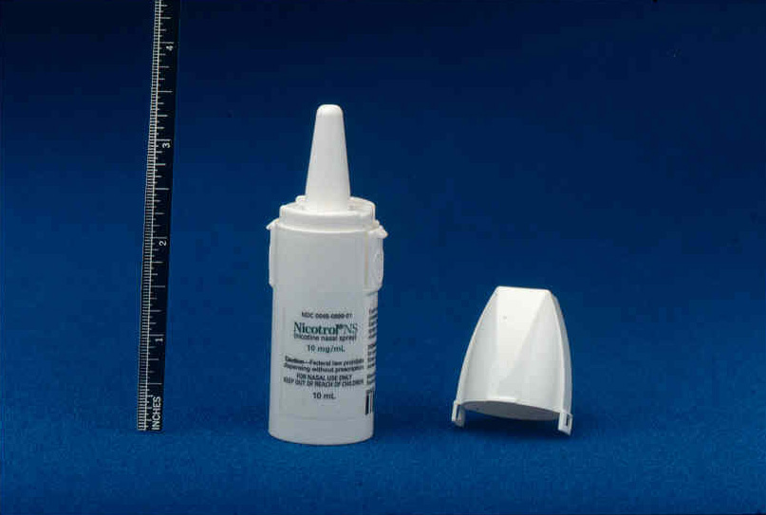

Slide 23


Slide 24
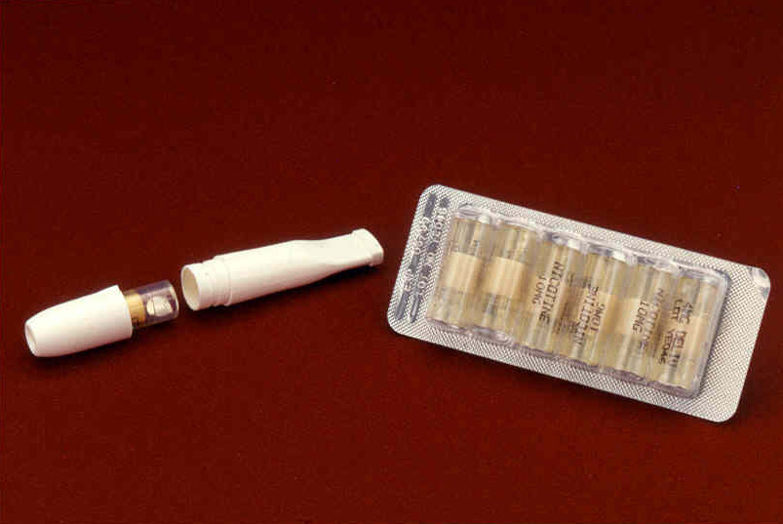

Slide 25


Slide 26
Bupropion
Background
Monocyclic antidepressant
Inhibits reuptake of norepinephrine and dopamine
May inhibit nicotinic ACH receptor function
Mechanism in helping smokers stop is not clear
May attenuate weight gain in abstinent smokers

Slide 27
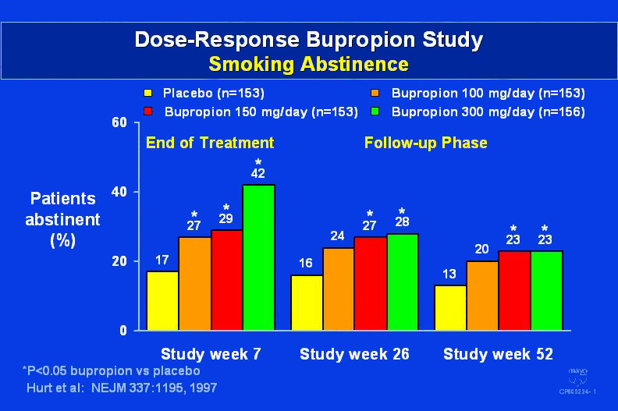

Slide 28
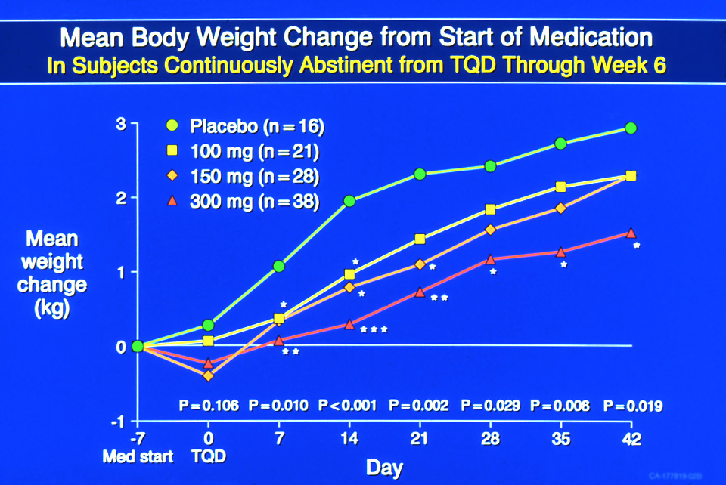

Slide 29
Bupropion for Relapse Prevention in Smokers
Weeks 1-7
Open label bupropion
300 mg/d
Week 52
Bupropion 300 mg/d
Week 104
Follow-up
Placebo

Slide 30
Bupropion for Relapse Prevention
Results
58.8% smoking abstinence at week 7
Relapse rate lower in active group through weeks 12 and 24 but not thereafter
Median time to relapse 156 d (active) vs. 65 d (placebo)
Smoking abstinence 47.7% (active) vs. 37.7% (placebo) through week 78
Weight gain 3.8 and 4.1 kg (active) vs. 5.6 and 5.4 kg (placebo) at weeks 52 and 104
Hays JT. Ann Intern Med 135:423, 2001

Slide 31
Bupropion
Side Effects
Relatively free of anticholinergic, sedative, cardiovascular or sexual dysfunction side effects
Most common side effects: dry mouth and insomnia
Seizure incidence 0.1%
Hypertension

Slide 32
Bupropion
Summary
Dose response efficacy in treating smokers
Attenuates weight gain
More effective than nicotine patch therapy
Delays relapse to smoking
Can be prescribed to diverse populations of smokers with expected comparable results
Hays JT & Ebbert JO. Mayo Clin Proc 78:1020, 2003

Slide 33
Varenicline
Mode of Action
Partial agonist with specificity for the α4B2 nicotine acetylcholine receptor
Agonist action: stimulates the nACHr to ↓ nicotine withdrawal
Antagonist action: blocks the nACHr to ↓ the reinforcing effect of smoking

Slide 34
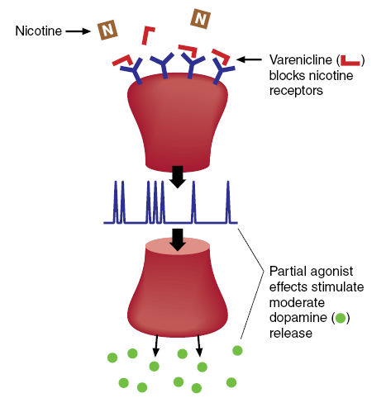
Varenicline
Mechanism of Action

Slide 35
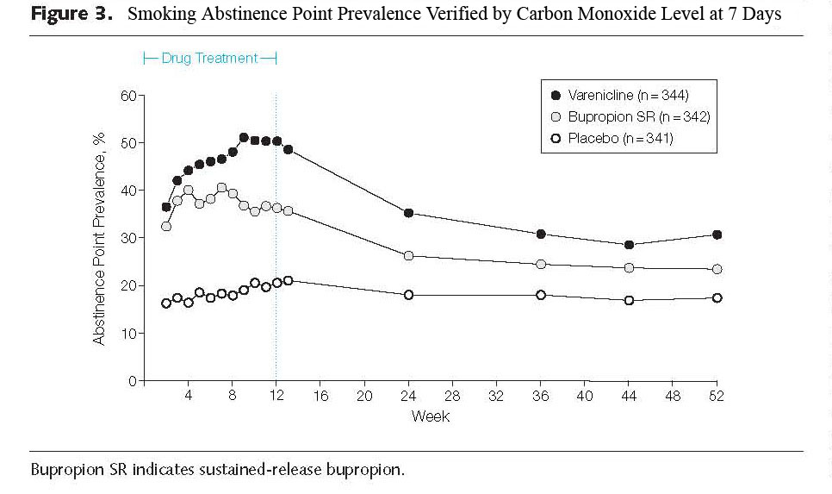
Varenicline vs. Bupropion vs. Placebo
Jorenby, D.E., et. al. JAMA; 296:56-63, 2006

Slide 36
Varenicline vs. Bupropion vs. Placebo
Side Effects
 | Varenicline N=692 | Bupropion N=669 | Placebo N=684
Nausea | 28% | 10% | 9%
Headache | 14% | 11% | 12%
Insomnia | 14% | 22% | 13%
Abnormal Dreams | 12% | 6% | 5%
Dry Mouth | 6% | 8% | 4%
Discontinuation because of AE’s | 10% | 14% | 8%

Slide 37
Maintenance of Abstinence
Study Design
OPEN-LABEL
DOUBLE-BLIND
NONTREATMENT
FOLLOW-UP
Varenicline 1mg bid
Varenicline 1mg bid
12 weeks
Quitters randomized
Placebo
Wk12
24
52
Primary Endpoint:
CO-confirmed continuous abstinence rate wk 13–24
Subjects
Male or female outpatient cigarette smokers
18-75 yr old, motivated to quit smoking
Average of ≥10 cigarettes/day during past year
Secondary Endpoint:
CO-confirmed continuous
abstinence rate wk 13–52
Notes:
The aim of the third study was to understand whether further treatment with Varenicline for 12 weeks helped smokers who had quit on Varenicline to remain smokefree. Again smokers who were motivated to quit and who smoked at least 10 cigarettes a day during the past year were eligible. These smokers then started a 12-week, open-label Varenicline treatment phase in which they were encouraged to quit by day 8 of treatment.
Subjects who did not smoke a single puff of a cigarette in week 12 at the end of the treatment were then randomized to either a further 12 week course of Varenicline or to placebo. Weekly clinic visits from the start of the study to week 24 provided motivational support and follow-up. Visits were also scehduled after the end of treatment to week 52. The primary endpoint was abstinence from even a single puff of a cigarette during weeks 13 to 24 and the secondary endpoint was abstinence during weeks 13 to 52. Both these quit rates had to be confirmed by CO measurements in expired breath.

Slide 38
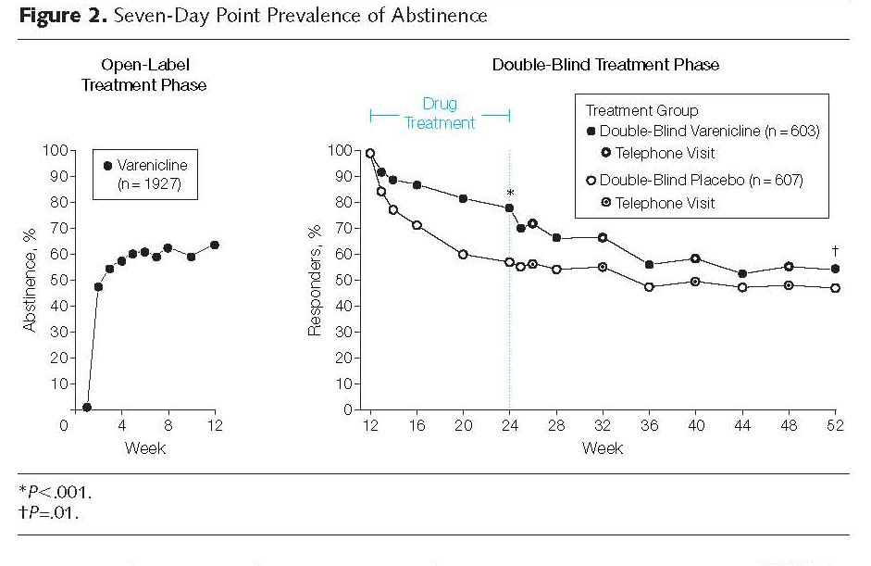
Varenicline Maintenance Study
Tonstad, S., et. al. JAMA; 296:64-71, 2006

Slide 39
Varenicline: FDA Warning
“All patients being treated with Chantix should be observed for neuropsychiatric symptoms including changes in behavior, agitation, depressed mood, suicidal ideation, and suicidal behavior. These symptoms, as well as worsening of pre-existing psychiatric illness, have been reported in patients attempting to quit smoking while taking Chantix…”

Slide 40
Varenicline and Neuropsychiatric Symptoms
Advise patients and family members that this has been observed
Ask patients and/or family to report any symptoms like this to you
Patients with serious psychiatric comorbidity were not included in clinical trials
No cause and effect relationship has been established

Slide 41
Varenicline
Summary
First selective α4B2 partial agonist
Effective in initiating smoking abstinence and longer term use improves long term smoking abstinence
Nausea is a frequent but mild side effect
To date appears to be safe and effective
First line pharmacotherapy
Possible combination use- bupropion

Slide 42
Triple Pharmacotherapy In Medically Ill Smokers
RCT nicotine patch (10 wks) vs nicotine patch + bupropion + nicotine inhaler (flexible duration)
Mean medication use: 35 d vs 89 d
Time to relapse: 23 d vs 65 d
AE generated discontinuance same in both groups
Smoking Abstinence at 6 months: 35% vs 19%
Steinberg MB et al, Ann Intern Med, 150: 447, 2009

Slide 43
Varenicline plus Bupropion
Open label pilot study in 38 smokers
Mean age 49 years, smoking 20 CPD for 30 years
12 weeks of varenicline and bupropion SR
Smoking abstinence at EOT 71% and at 6 months 58%
Sleep distrubance 26% and nausea 24%
Ebbert, JO et al, Nic & Tob Res, 3:234, 2009

Slide 44
Short-acting vs Long-acting vs Combination
N=1,504
RCT of lozenge, patch, patch + lozenge, bupropion + lozenge vs placebo
8 week treatment
All pharmacotherapies more effective than placebo
At 6 months nicotine patch + lozenge had best OR of 2.3, p<0.001 vs placebo
Piper, ME et al, Arch Gen Psychiatry 66:1253, 2009

Slide 45
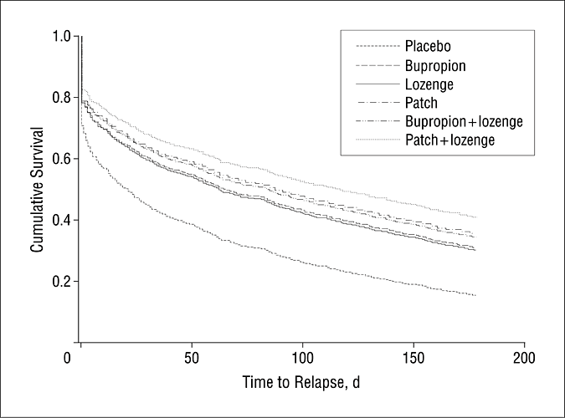
Piper, M. E. et al. Arch Gen Psychiatry 66:1253-1262 2009

Slide 46
Treating Tobacco Dependence in a Medical Setting
Pharmacotherapy
Clinical decision-making using clinician skills and knowledge of pharmacology to decide on medication selection and doses
Patient involvement: past experience and/or preference
Nicotine patch, varenicline and/or bupropion viewed as “floor” medications
Short acting NRT products for withdrawal symptom control
Combination pharmacotherapy frequently used
Hurt RD, et al CA Cancer J Clin 59:314, 2009

Slide 47
Mayo Clinic Nicotine Dependence Center
Treatment Program
Established April 1988
Integrated approach – behavioral, addictions, pharmacotherapy, relapse prevention and motivational interviewing.
Outpatients- Individual counseling by TTS.
Inpatients- Hospital nurse Tobacco Use Intervention Protocol and Nurse Practitioner TTS
Residential treatment program

Slide 48


Slide 49
Individualized Plan
http://ndc.mayo.edu

Slide 50
Mayo Nicotine Dependence Center
Residential Treatment Program
8 day multicomponent treatment in a residential unit
Tobacco-free protected milieu
Daily physician and counselor rounds
Group and individual therapy and education sessions
Tailored pharmacotherapy
Proactive follow-up for relapse prevention
Hays JT, et al. Mayo Clin Proc 76:124, 2001

Slide 51
Mayo Clinic Nicotine Dependence Center
April 1988 through April 2010
Initial Counseling 43,601
Follow-up Counseling 21,084
Residential 1,250

Slide 52
Mayo Nicotine Dependence Center
Treatment Outcomes
Individual outpatient counseling | 23-27%
Individual bedside counseling | 32%
Residential treatment | 52%
Croghan IT et al, Addict Behav 34:61, 2009
Hays JT Mayo Clin Proc 76:124, 2001

Slide 53


